Slide 1
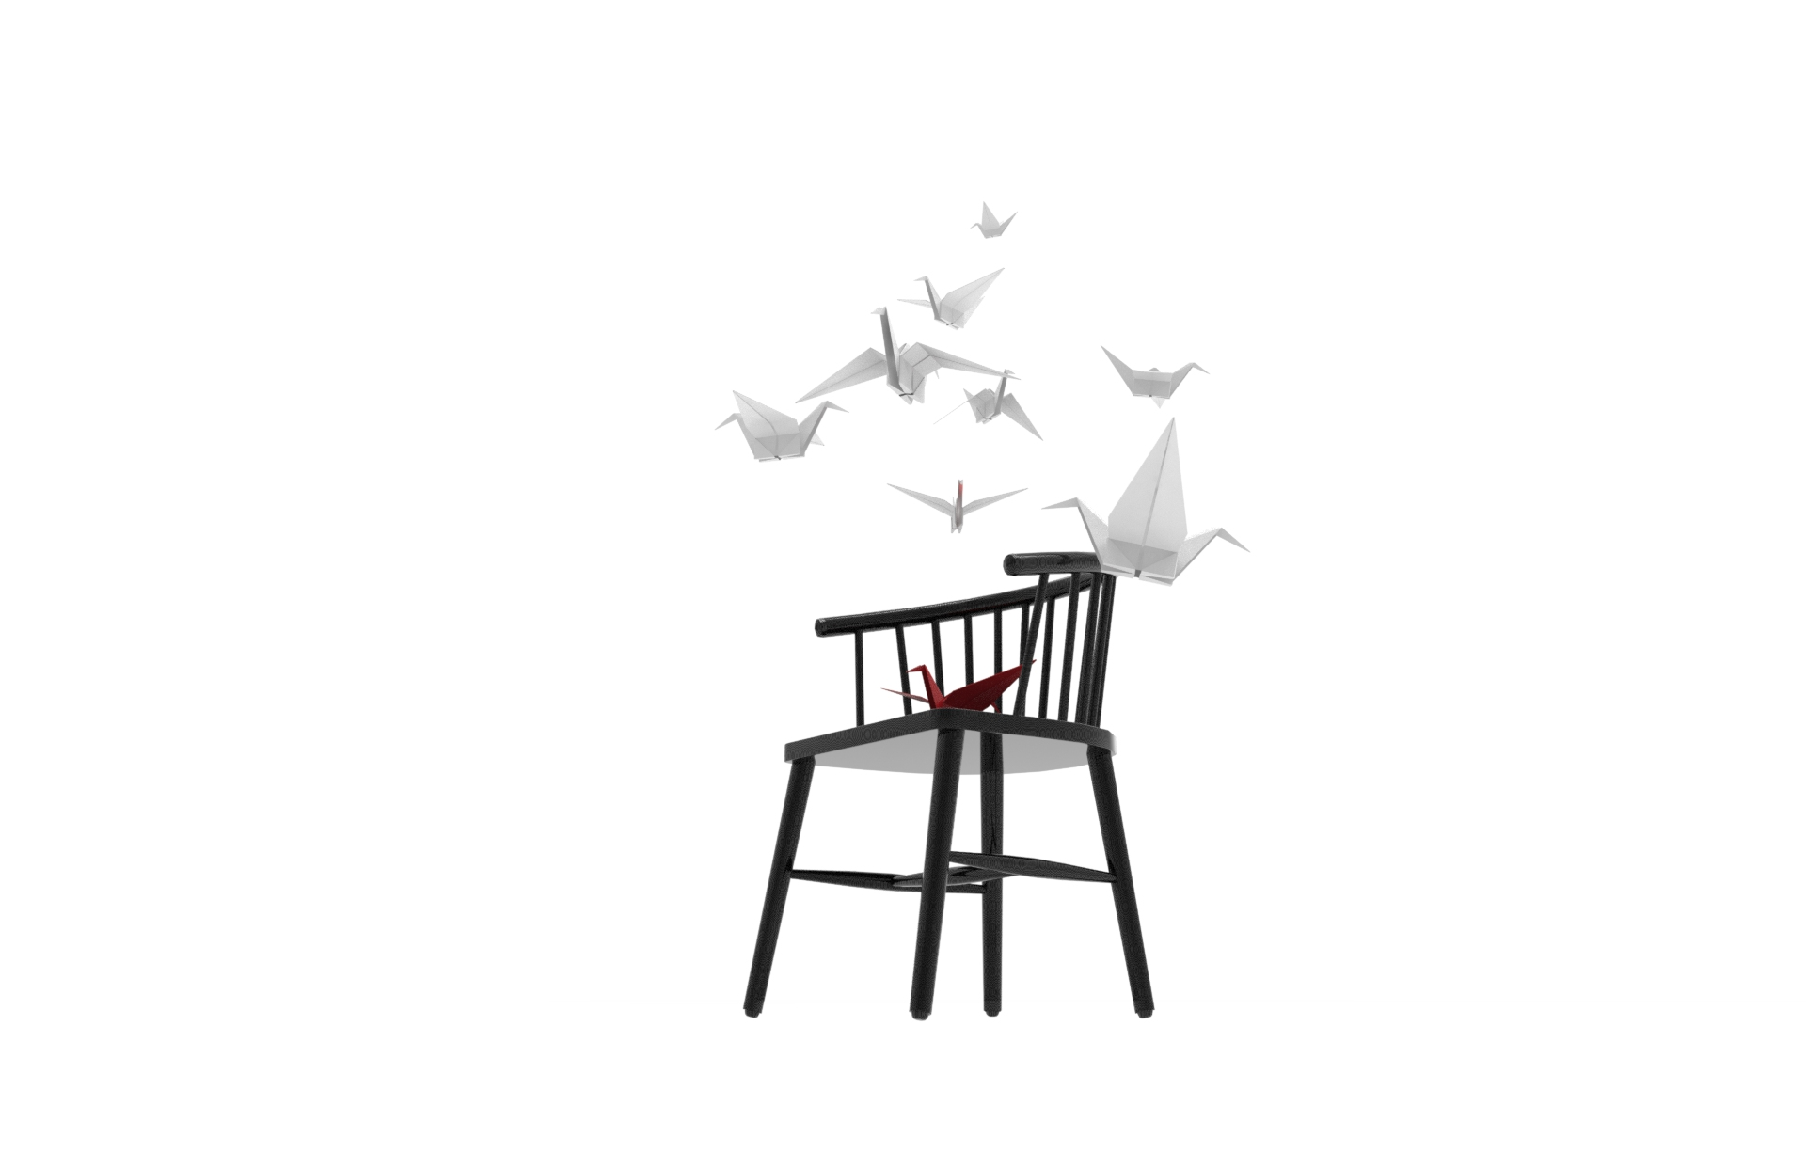
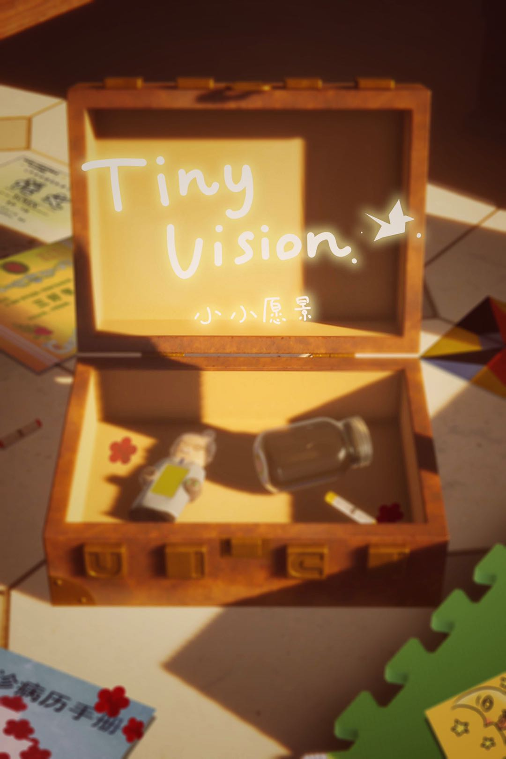


“TINY VISION”
3D PUZZLE GAME
BY WAW STUDIO

Slide 2
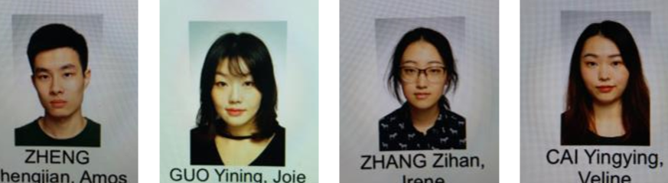










TEAM INTRO
VELINE
DESIGNER / MARKETER
JOIE
GAME ARTIST
AMOS
PROGRAMMER / ANIMATOR
IRENE
MODELLER / PROGRAMMER

Slide 3
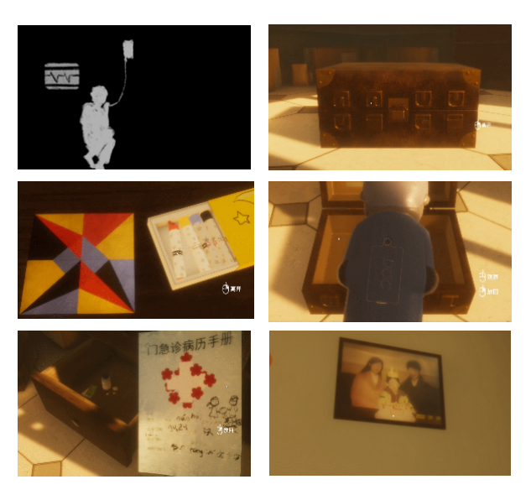
PROJECT INTRO
# ART
CHINESE RETRO IN 2000s
# GAMEPLAY
3D FIRST-PERSON
SOLVE PUZZLES
ROOM ESCAPE
# STORY
A LONELY BOY
A DREAM JOURNEY

Slide 4

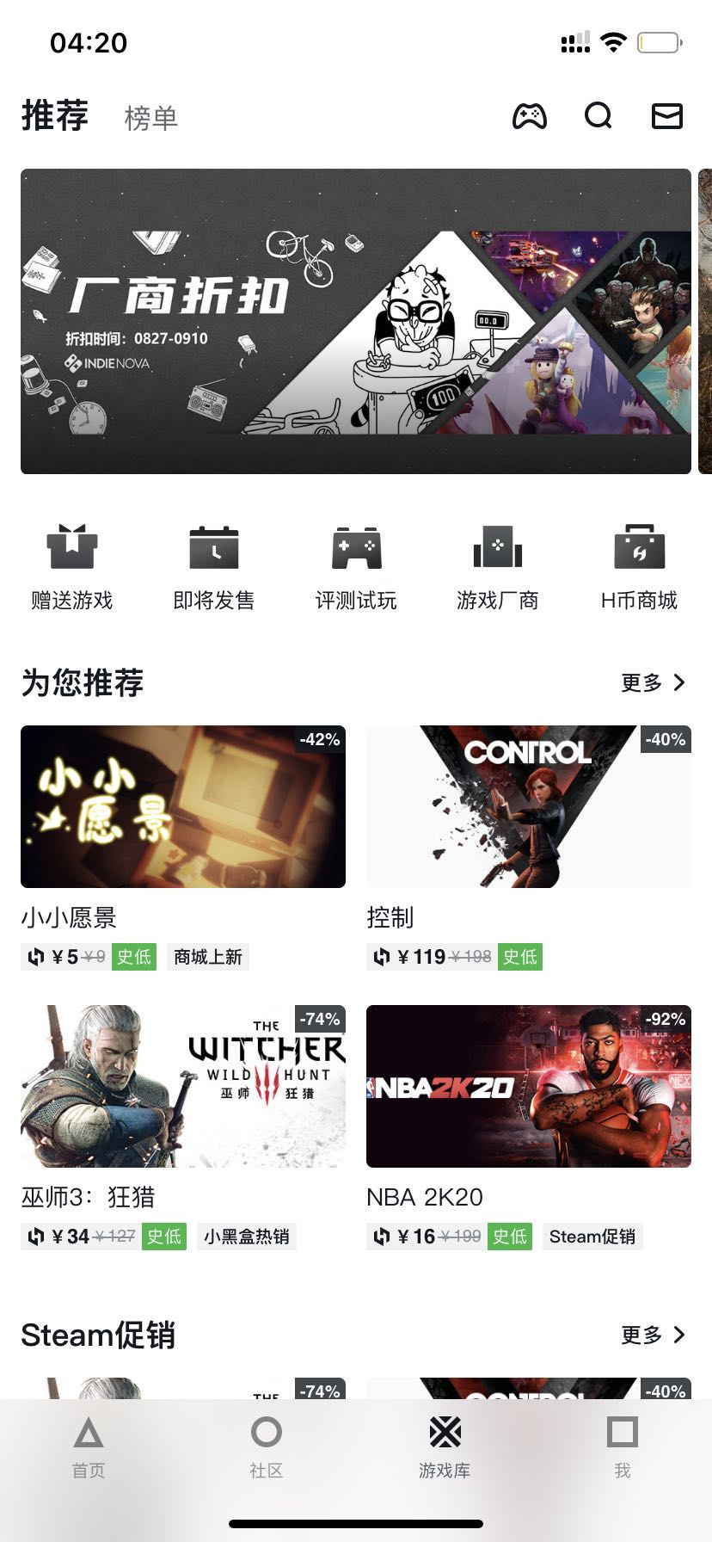
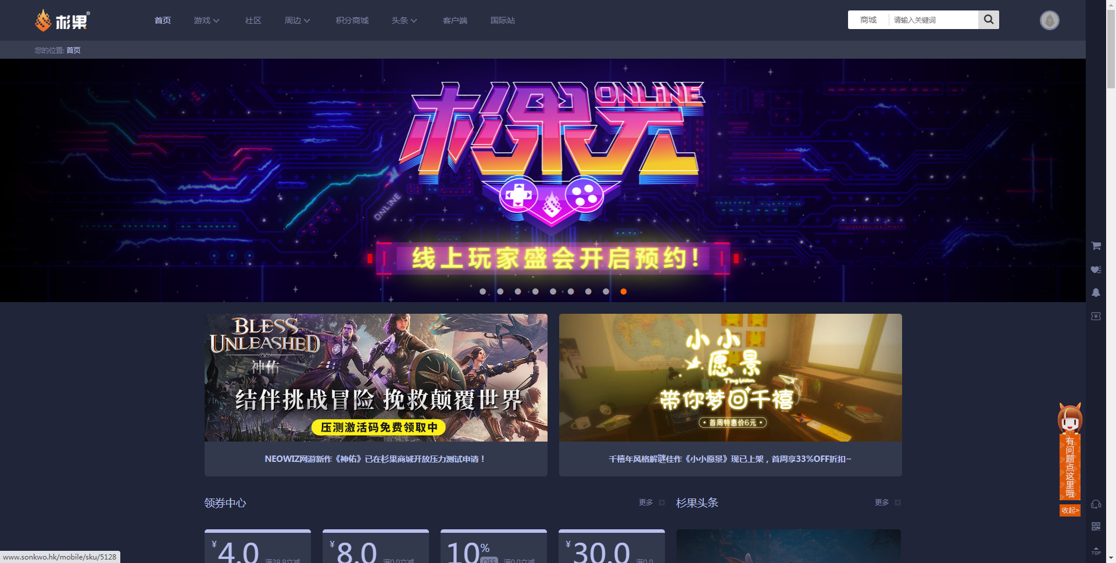


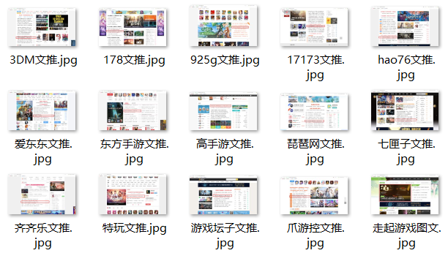


ACHIEVEMENT
362,200
1st WEEK!
Sale $250
1st WEEK!
News 20+
Top10

Slide 5

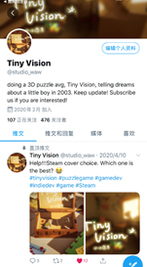
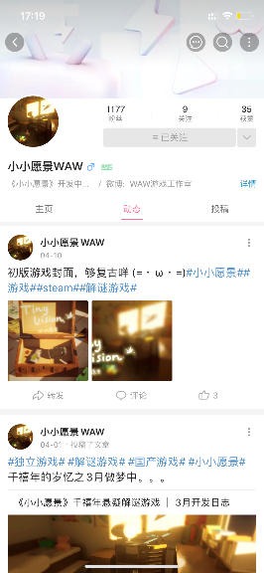
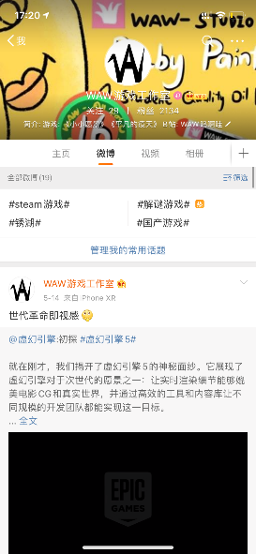
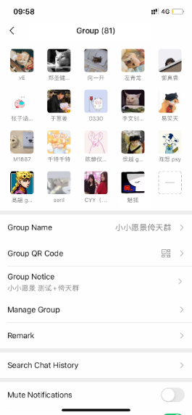
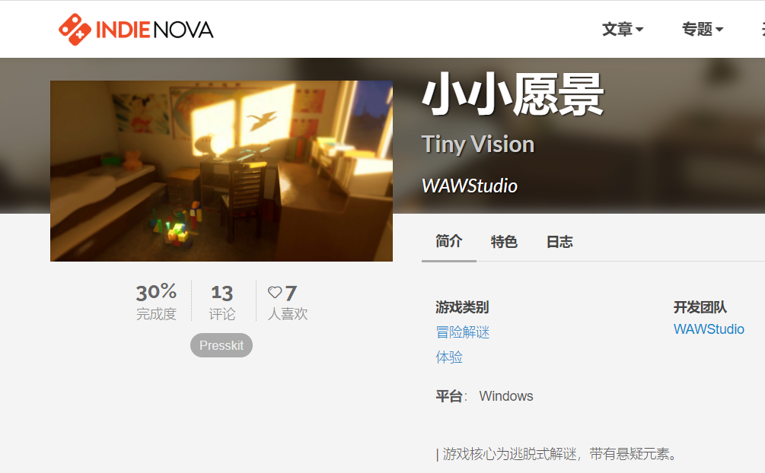
ACHIEVEMENT
4000+
START SINCE APRIL!
Indienova
Twitter
Bilibili
Weibo
WeChat Group

Slide 6


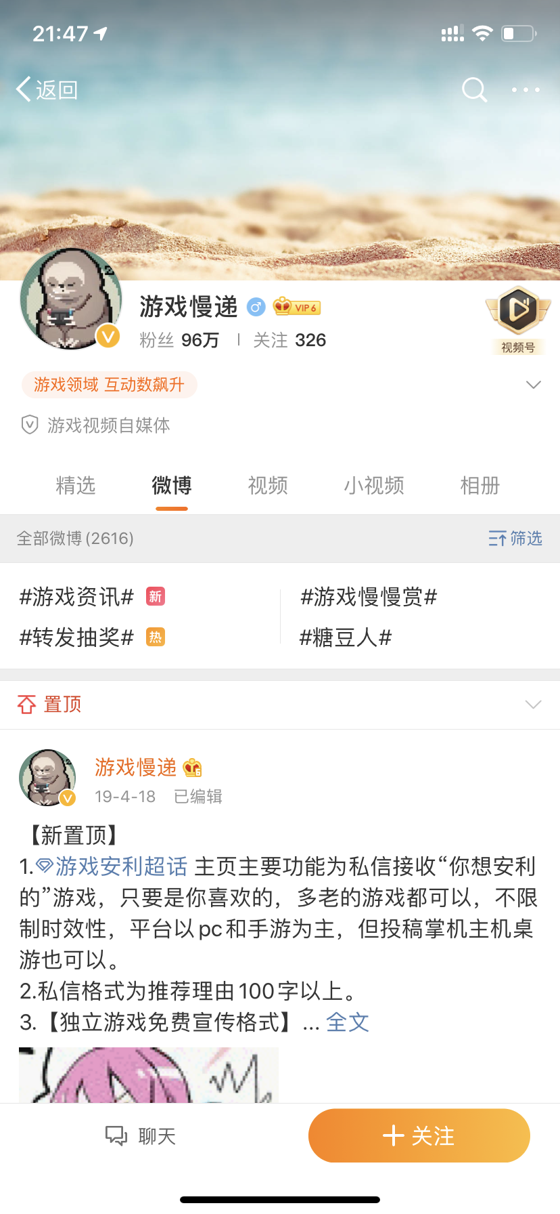
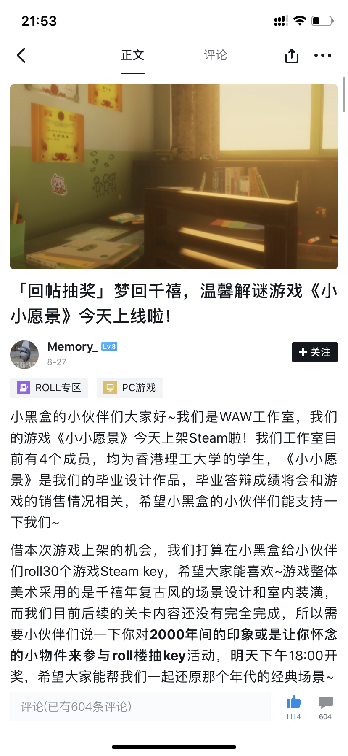
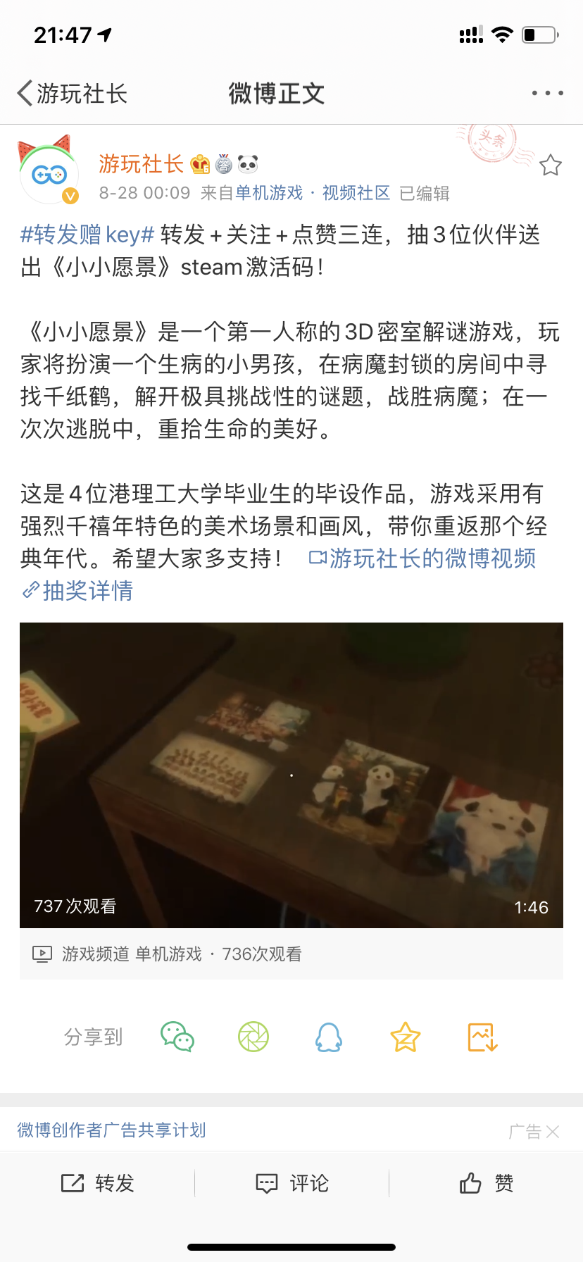
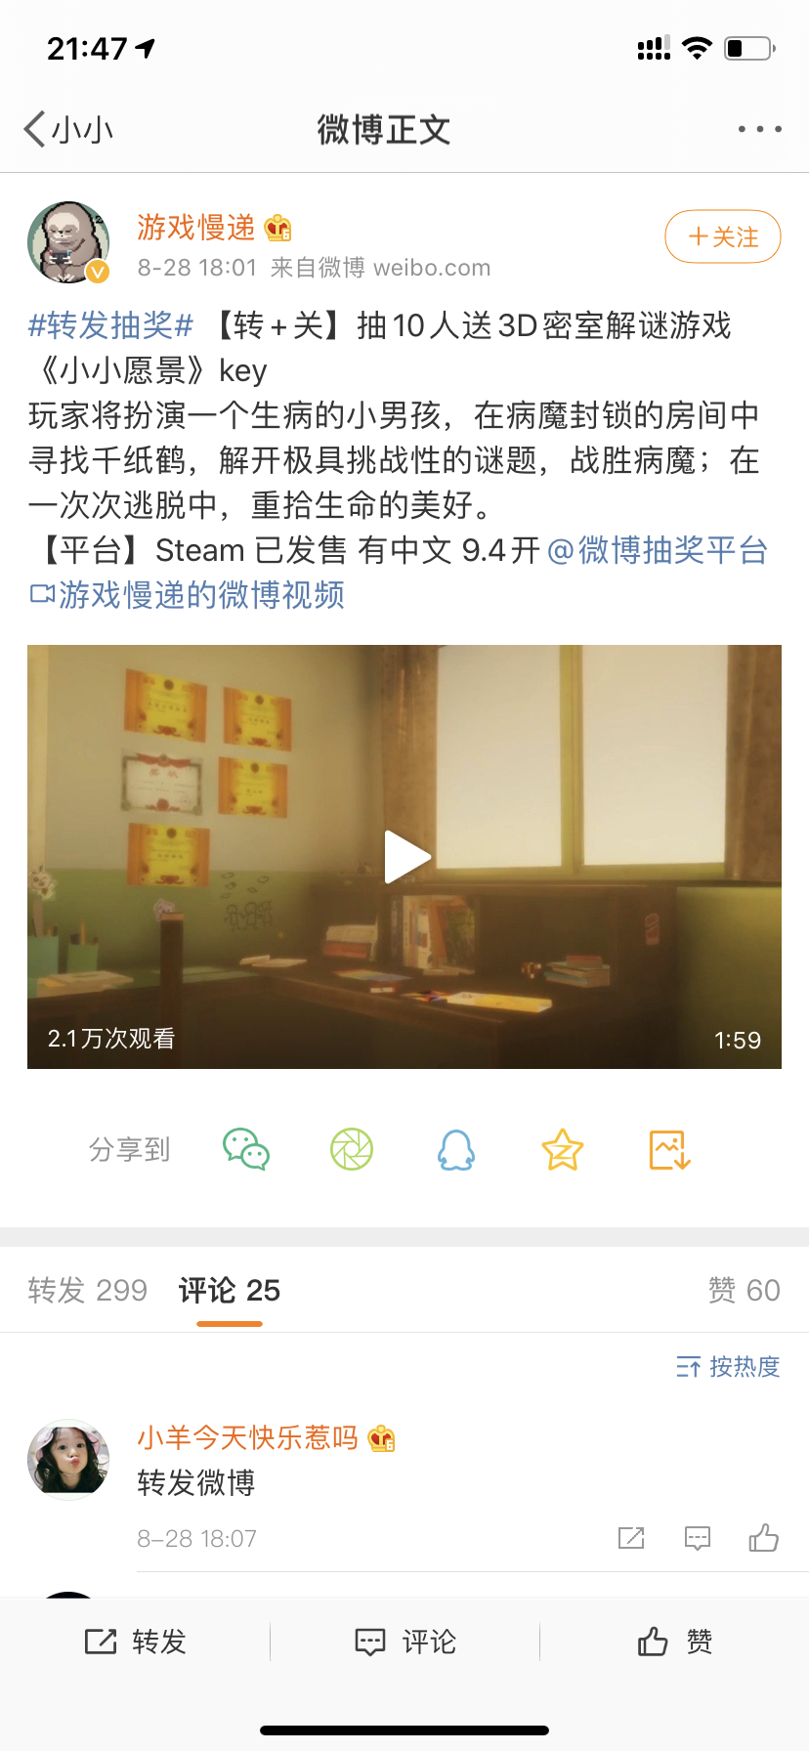
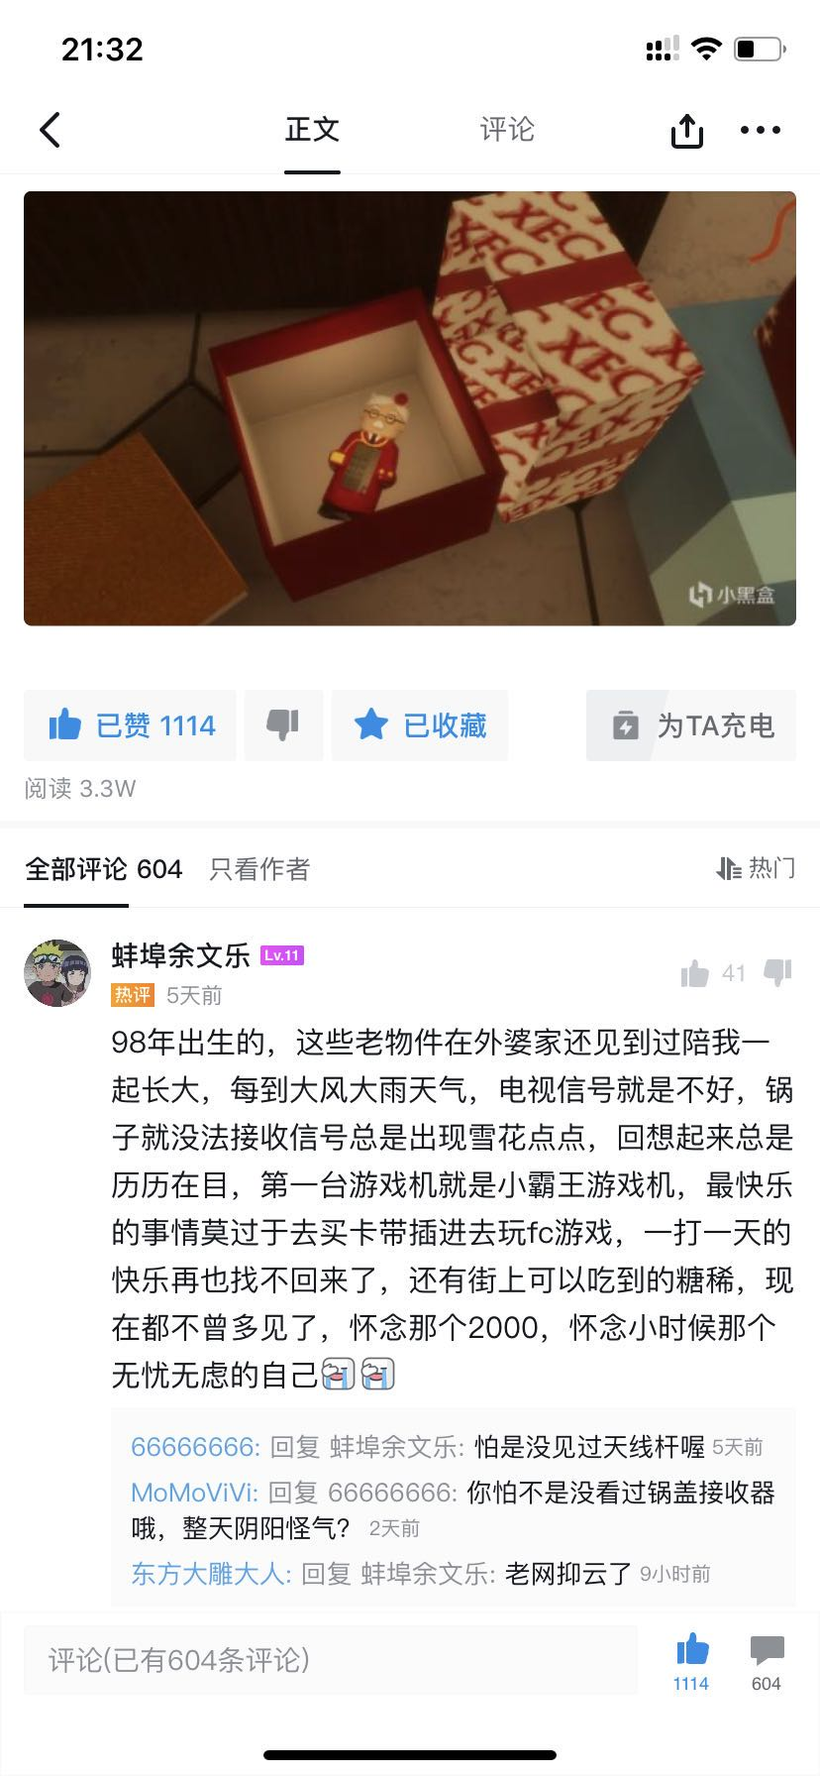
ACHIEVEMENT
Roll Keys
Influencer 30W
Influencer 96W
Blackbox 3W

Slide 7


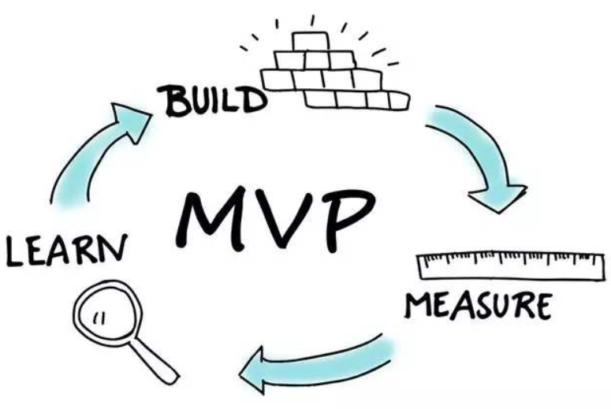
PROJECT MANAGEMENT
March
The Most
Important!
Skill
X
Need
DEMO1.0
GITEE.COM NEED LIST
ONLINE CHATTING
PER WEEK
Important!
Market
Desire
April
SOCIAL MEDIA
Time
Money
Basic
June
July
August
Aug 27th
DEMO2.0
TESTING
PUBLISHER
LAUNCH
MILESTONE

Slide 8
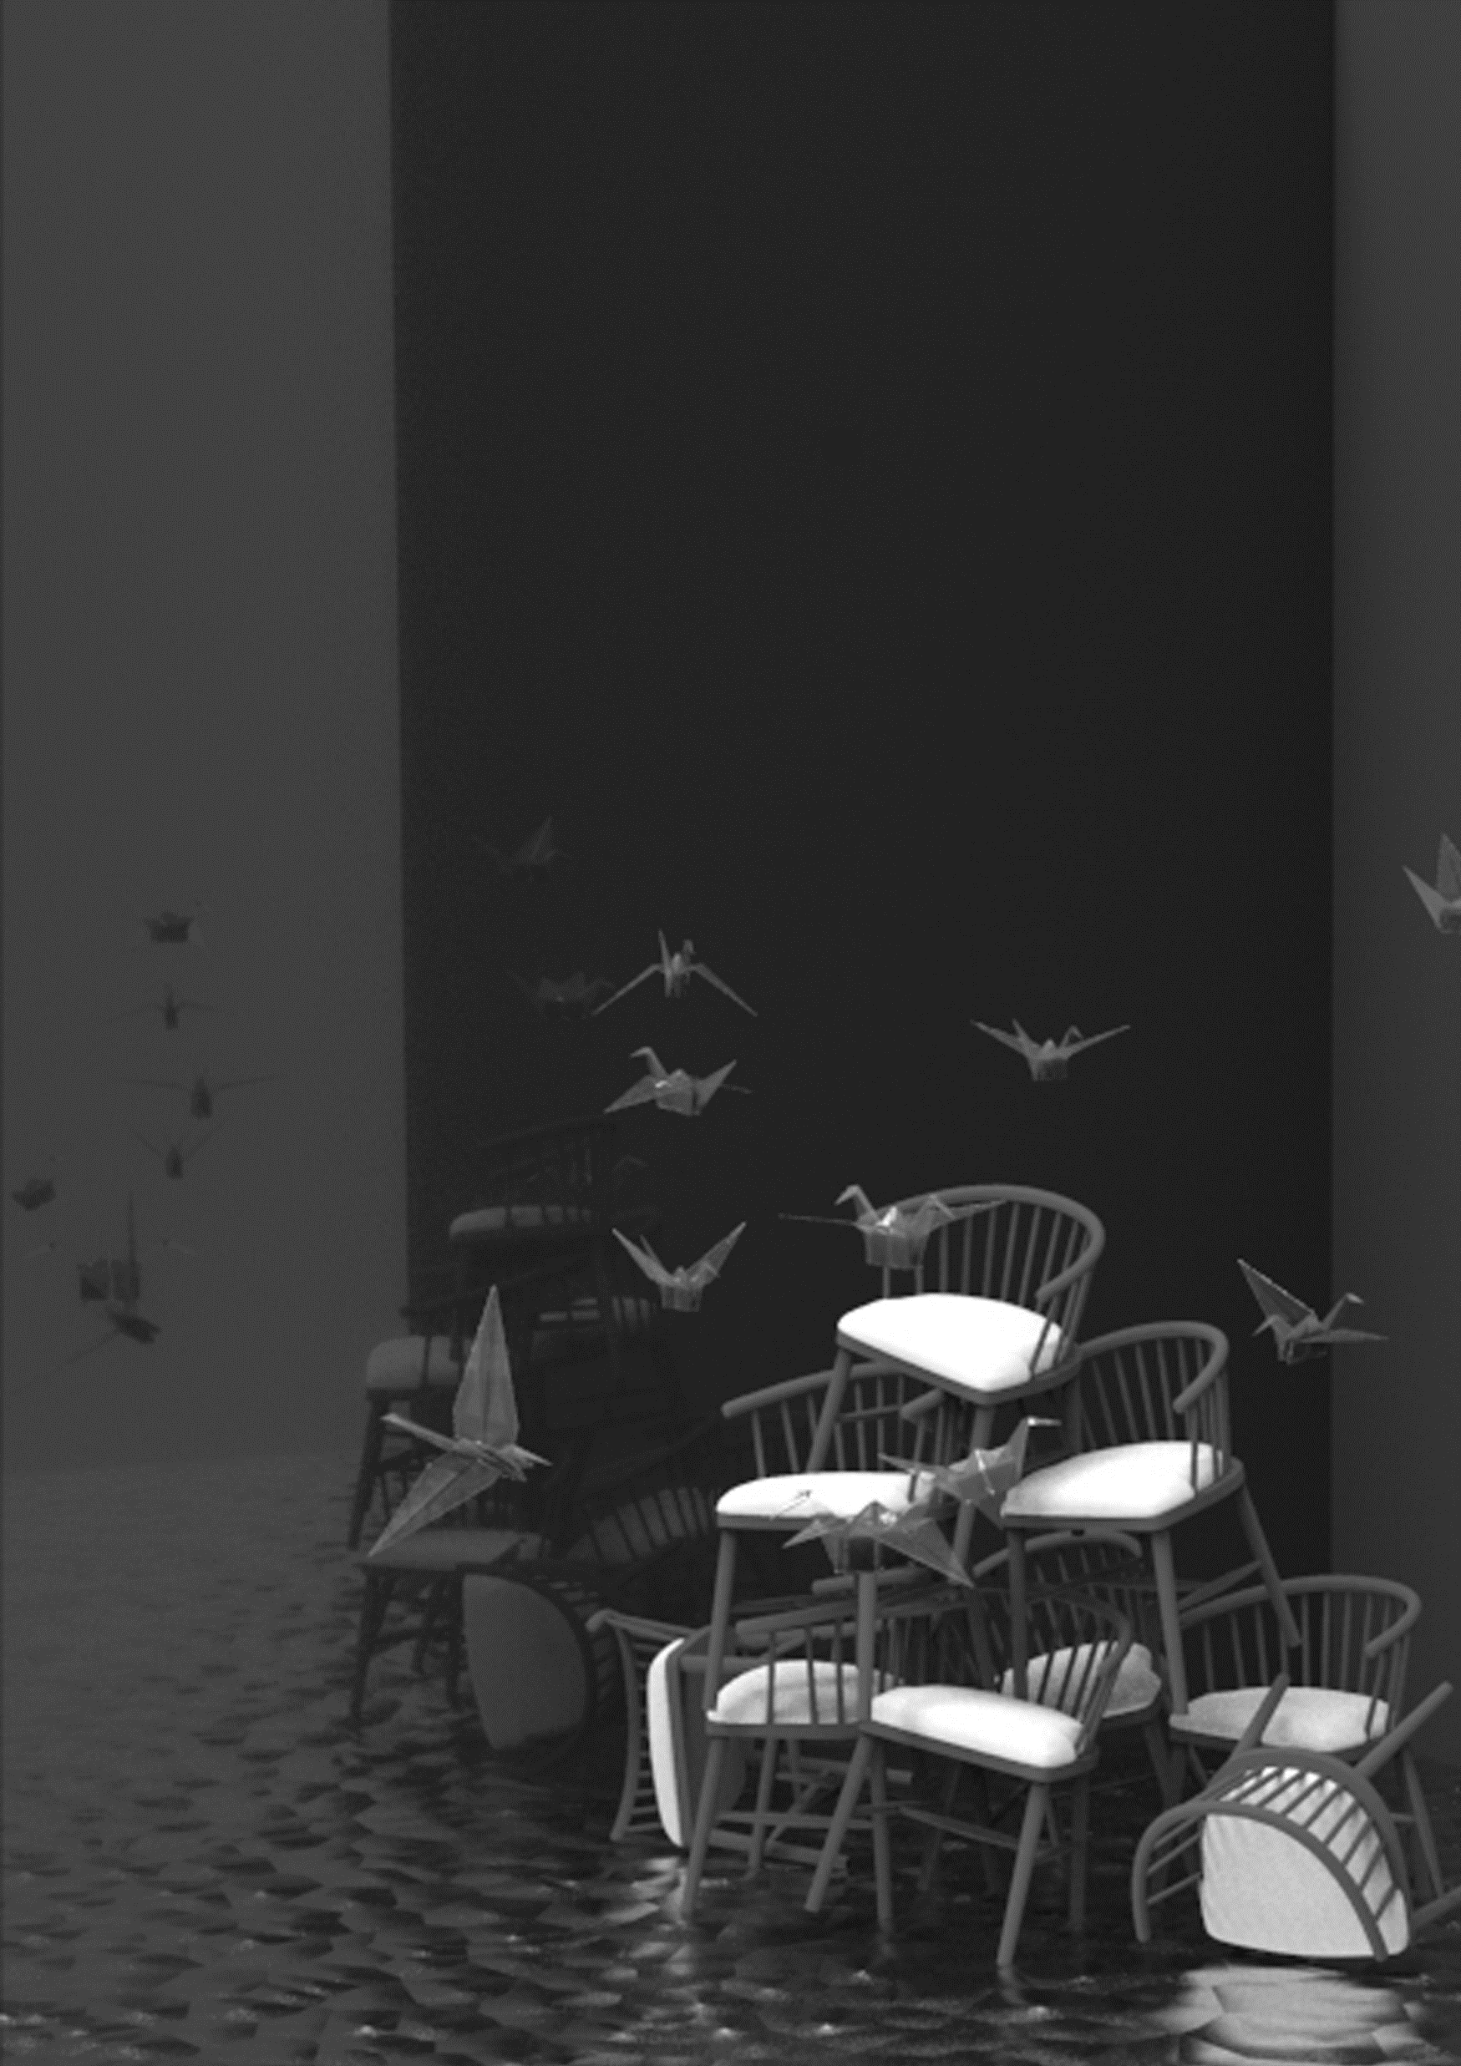
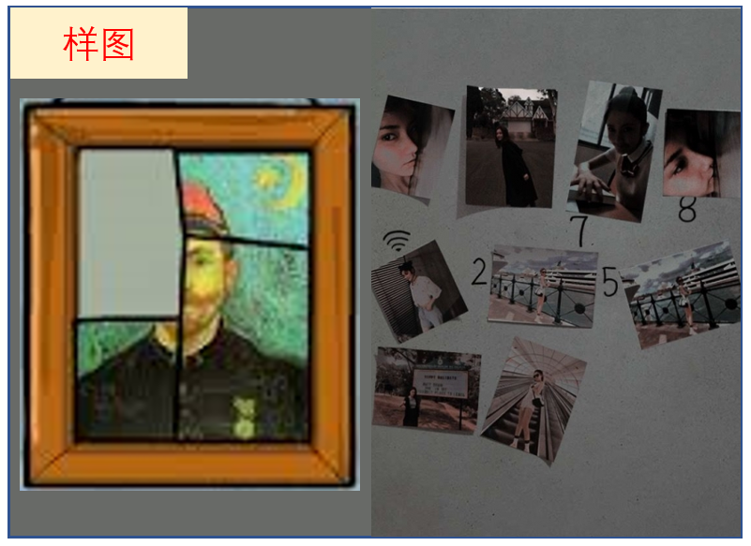
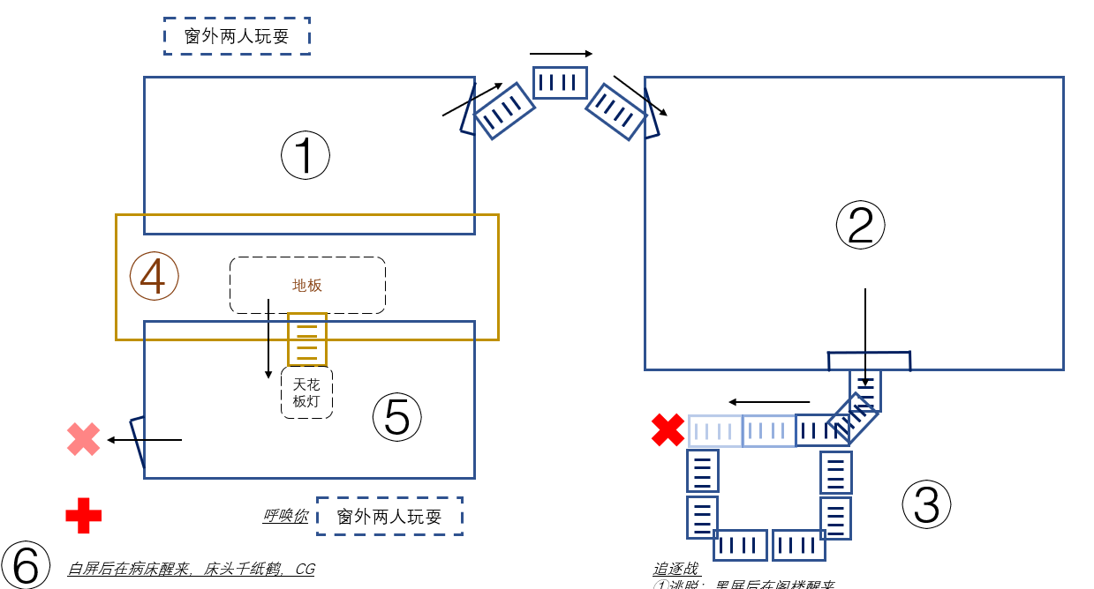
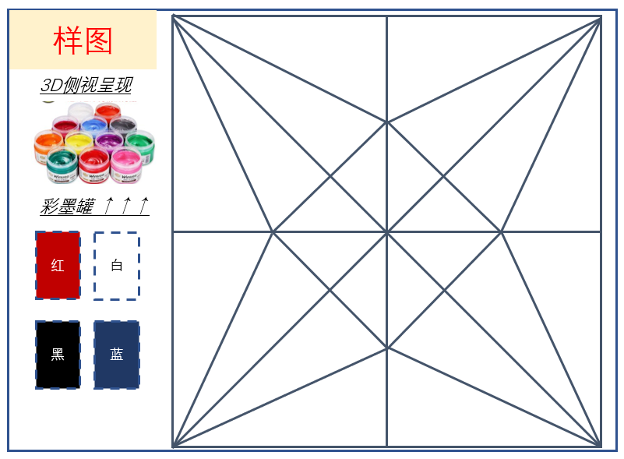
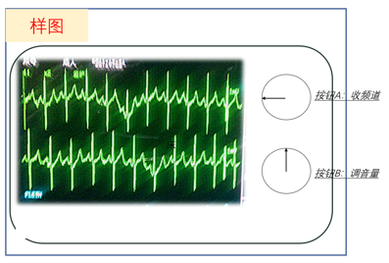






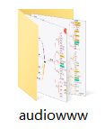

GAME DESIGN
ROOM 0 — tell the background — filming animation
ROOM 1 — tell story after sickness (in 2003)
ROOM 2 — tell story before sickness (in 2002)
Like paper crane
isolated
BGM
TRIGGER AUDIO
ENVIRONMENTAL AUDIO
sick
Like drawing
lonely
8-year-old

Slide 9
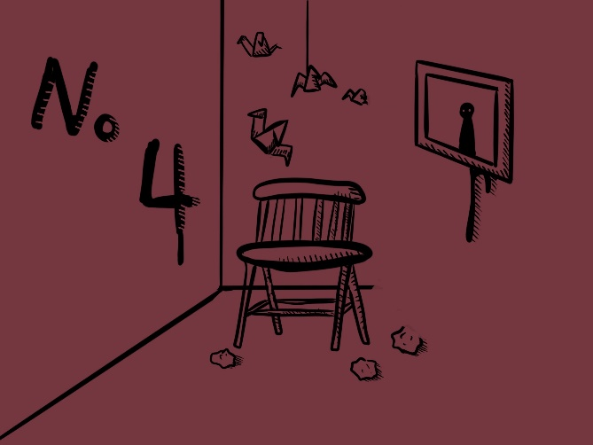
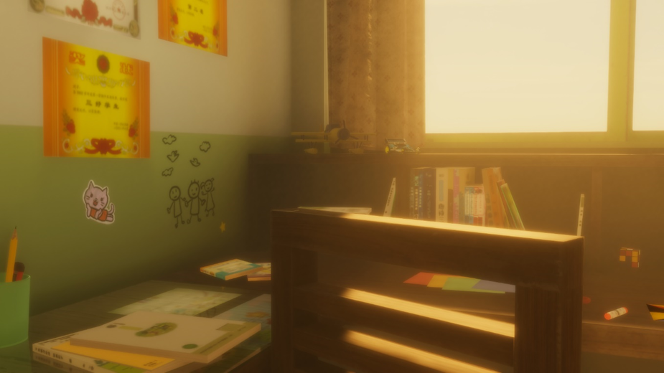
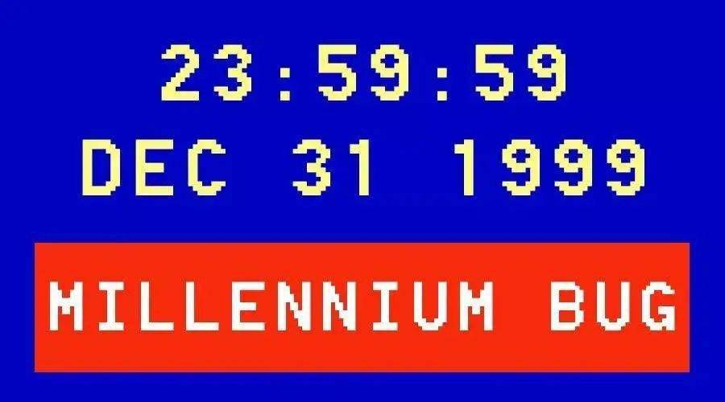

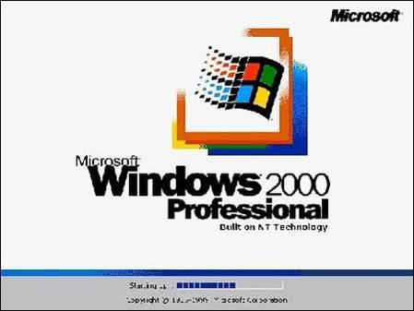
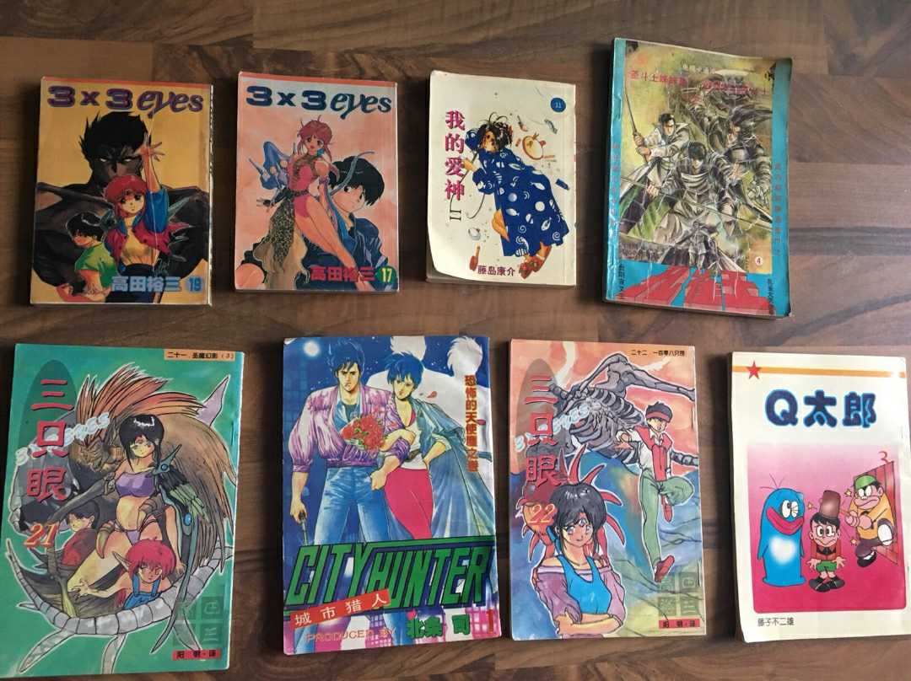

ART STYLE

Slide 10
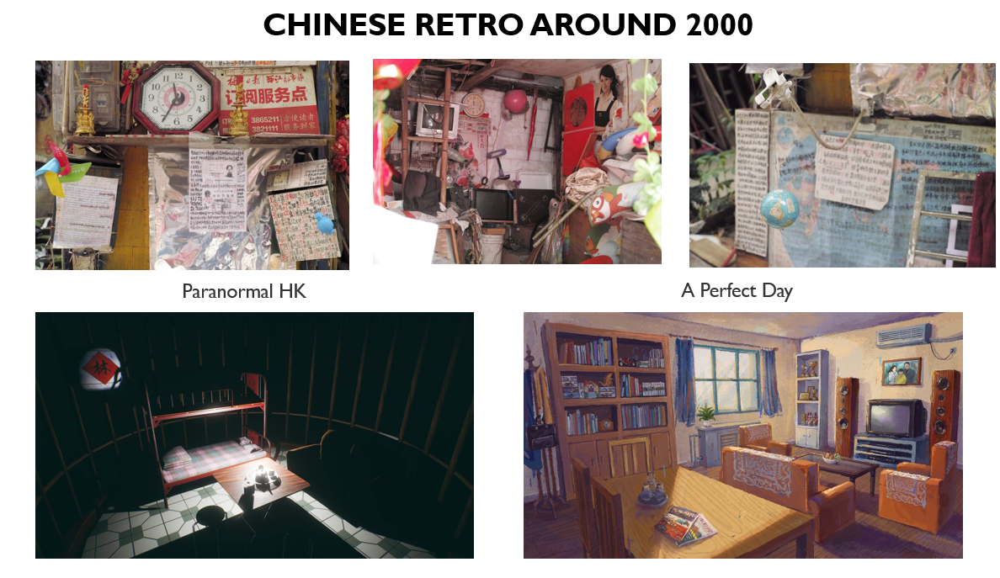
CHINESE RETRO AROUND 2000
Paranormal HK
A Perfect Day

Slide 11
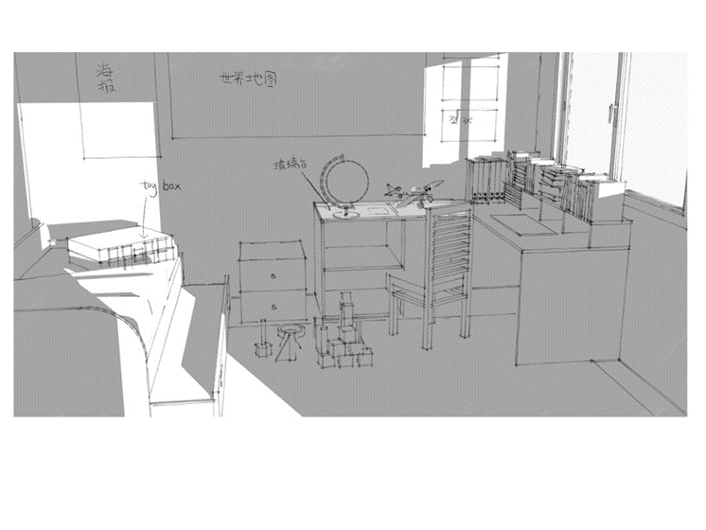
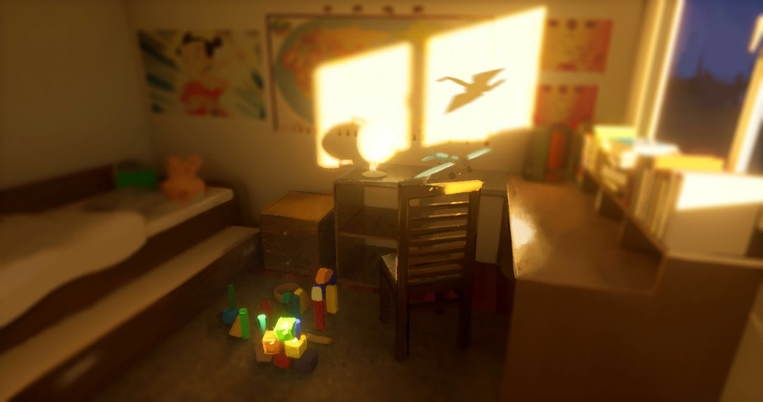
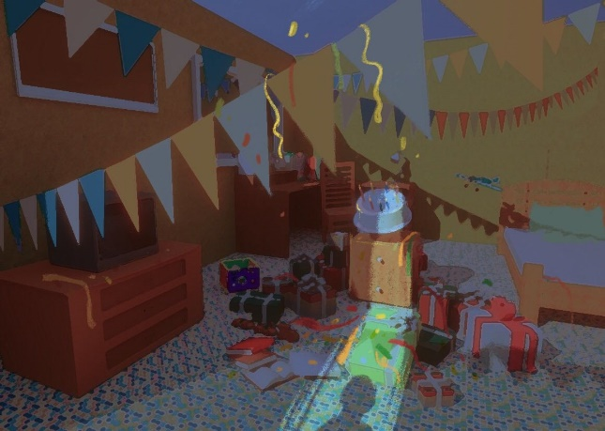
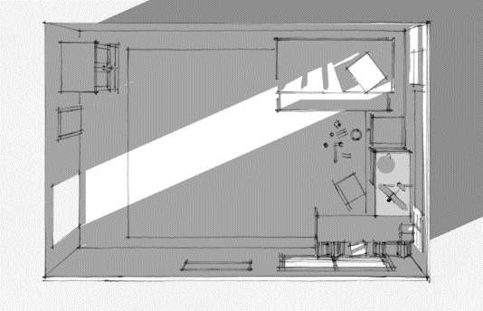
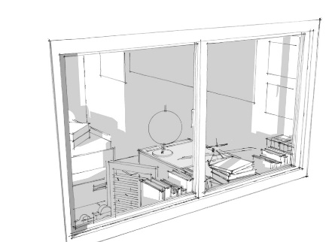
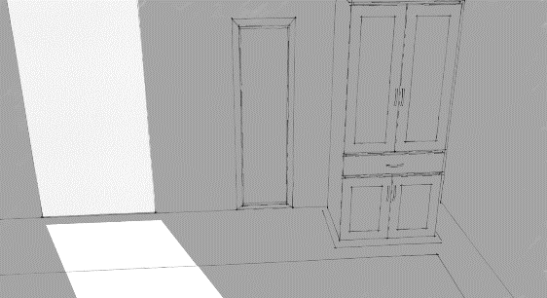
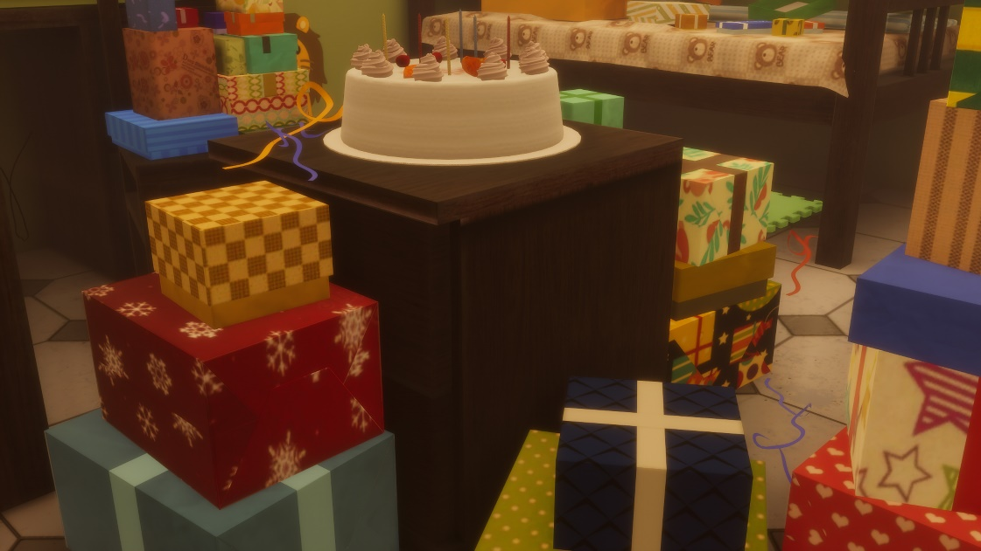
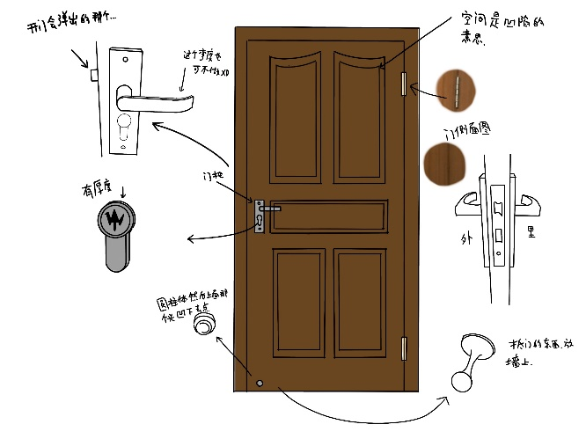
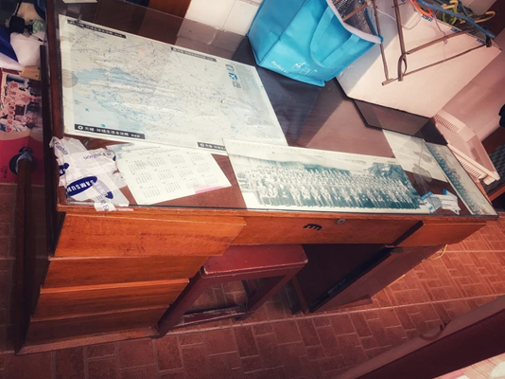
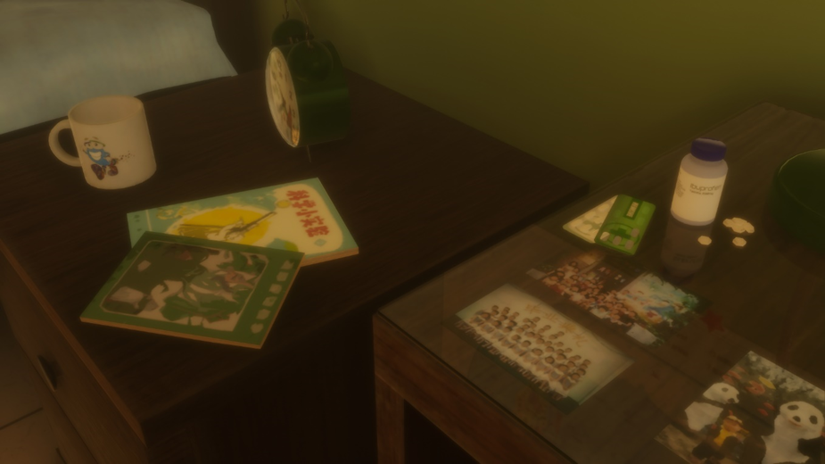
SCENE DESIGN

Slide 12
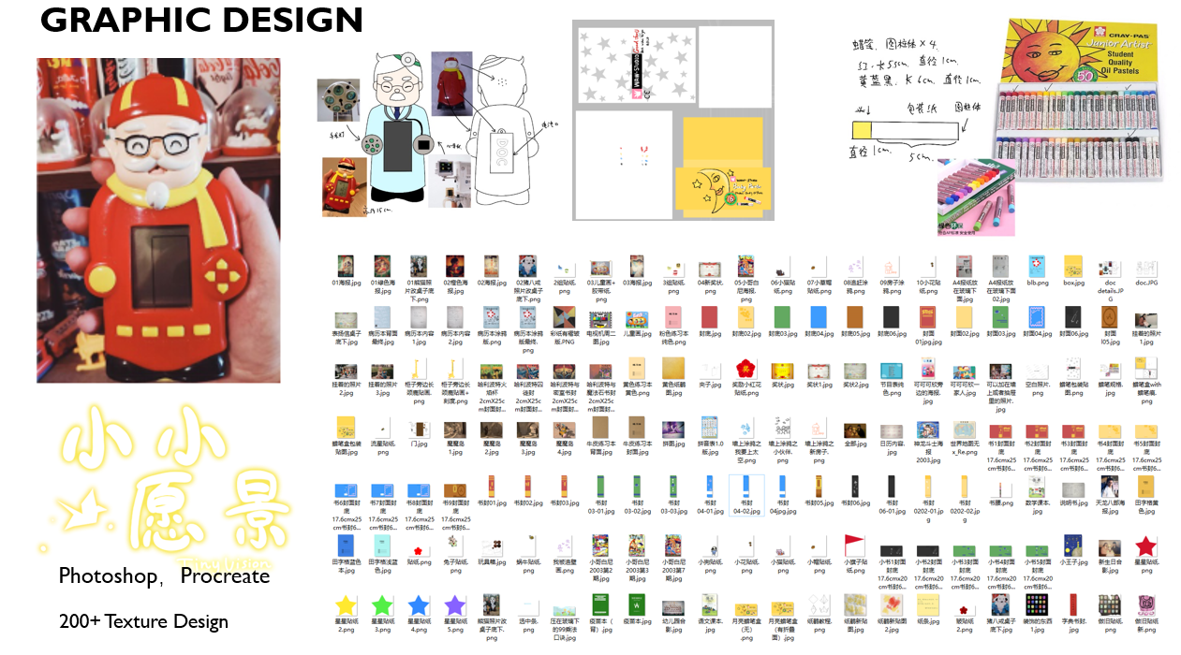
GRAPHIC DESIGN

Slide 13
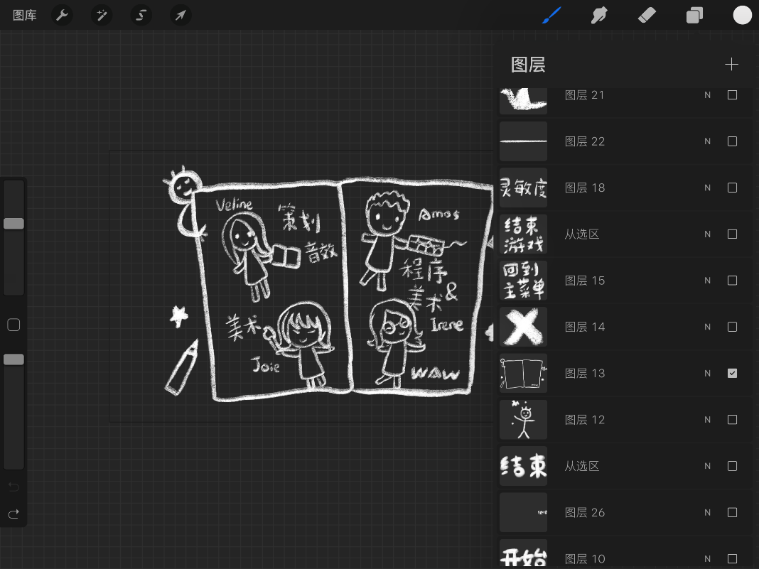
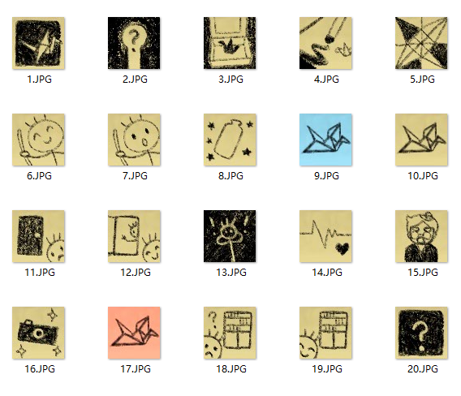
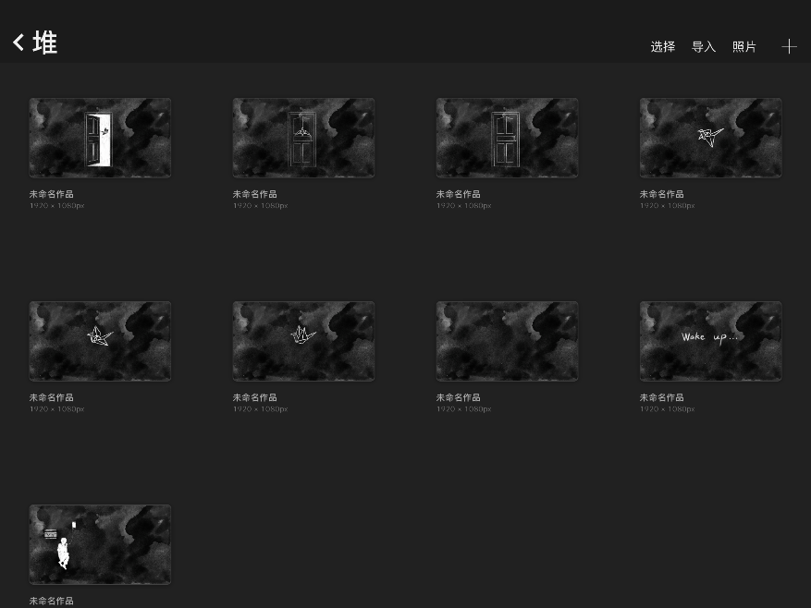
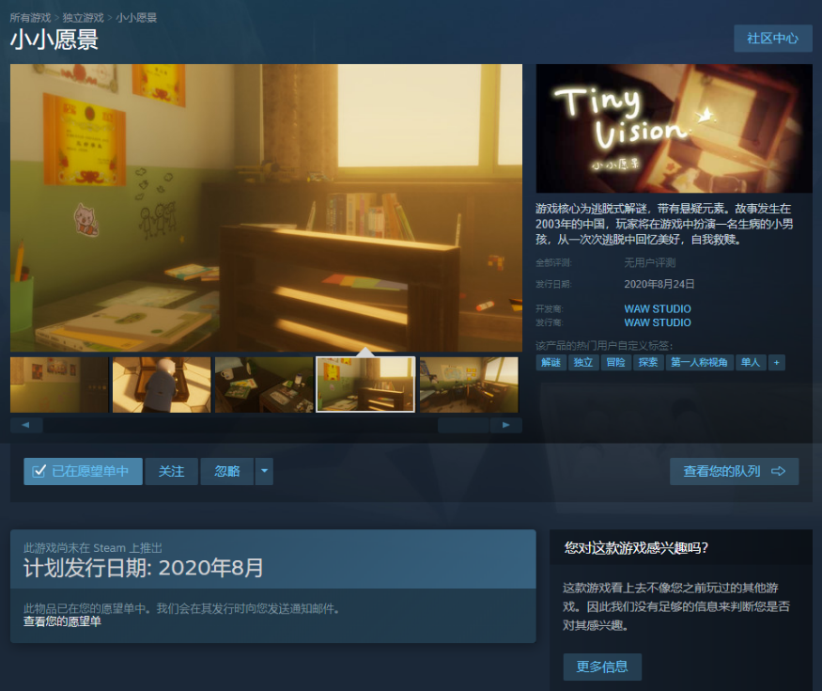
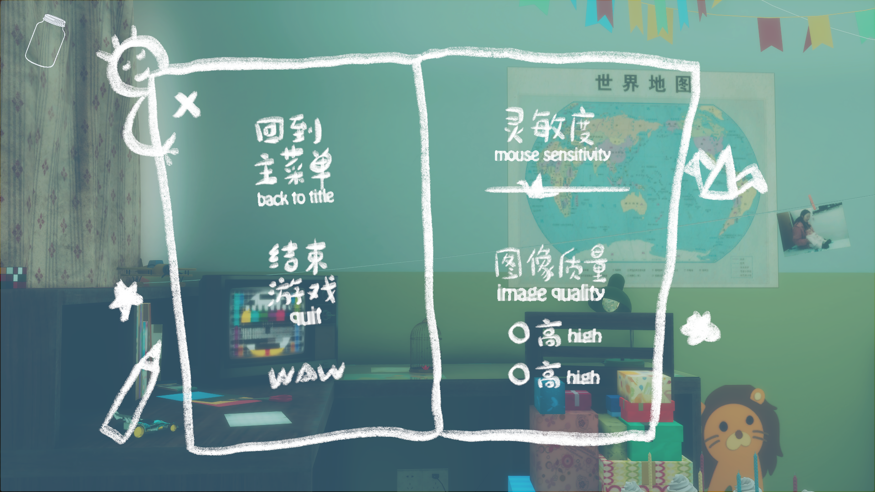
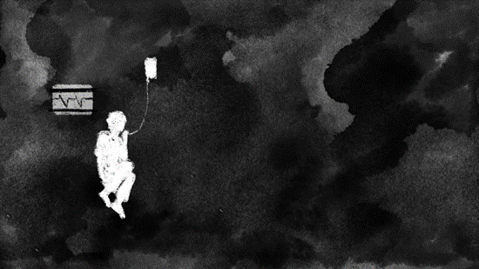
GRAPHIC DESIGN
Menu Design
UI of Achievement System
Animation Design
Steam Store Page Design

Slide 14
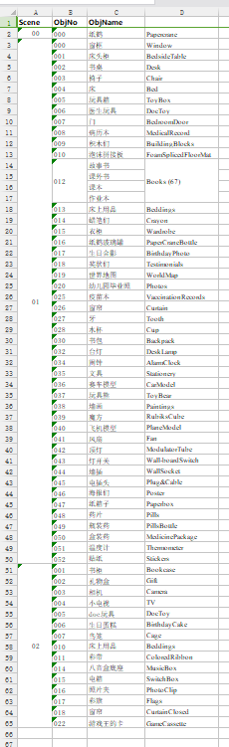
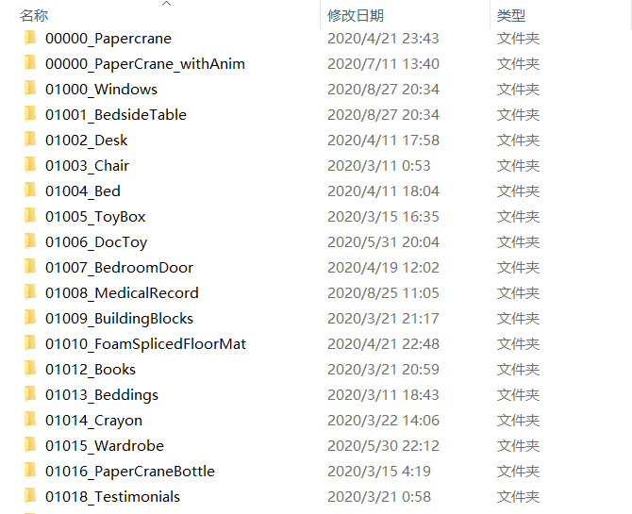
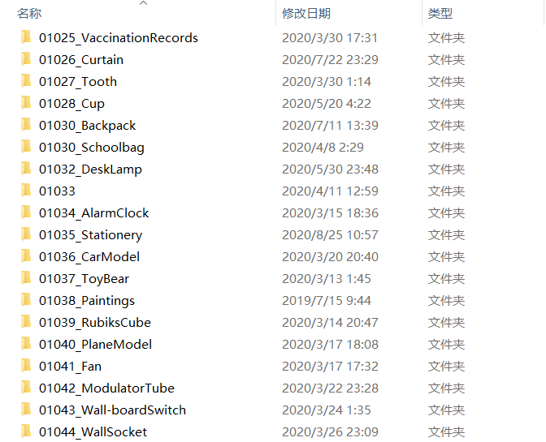








3D ART DESIGN

Slide 15






3D ART DESIGN
Modular
Procedural

Slide 16














UI DESIGN
Localization
Slected State

Slide 17




GAME ENGINE
Prototyping
→
Unity3D
HDRP (High Definition Render Pipeline)
Linear Color space
Decal System
Post-processing Volume
Physics-based lighting system
Unity Asset Store
Pro-builder
DO Tween
Import Material
→
Lighting
→
Finalized

Slide 18









PROGRAMMING
Breakdown
Cooperation（Gitee）
Development Process
Prototype
Inner Testing
Finalized

Slide 19

POST-PROCESSING
Lighting
Baking Lightmap
Realtime lighting
Light probe
Shader Graph & VFX Graph
Animation
Timeline (Animation sequence)
DO Tween plugin
Rendering Volume
Fog
Screen Space Refection

Slide 20

THANK YOU
BY WAW STUDIO

